Slide 1
New features in Office 365
Anita Mortaloni, anitase@microsoft.com
Senior Program Manager
Microsoft Office Product Group

Slide 2


Microsoft Mission
Microsoft Mission
Empower every person and every organization on the planet to achieve more
Notes:
Our mission, at Microsoft, is to empower every person and every organization on the planet to achieve more. We announced this new mission a couple of years ago. It’s a mission that connects back to our earliest days as a company, but is aimed directly at the opportunities and challenges that the world will face in the decades to come. And it’s only attainable if everyone has access and opportunity to achieve more…

Slide 3

Empowering People
Every person.
Empowered.
In every context.
Notes:
When we talk about empowering people we simply mean that with the right tools, anyone can do anything. That’s everyone. In every context.
And context matters. Here’s why…

Slide 4
Accessibility Built In to Boost Productivity For All
Consume Content Independently
Create Confidently
Collaborate Inclusively
Organize Efficiently

Slide 5
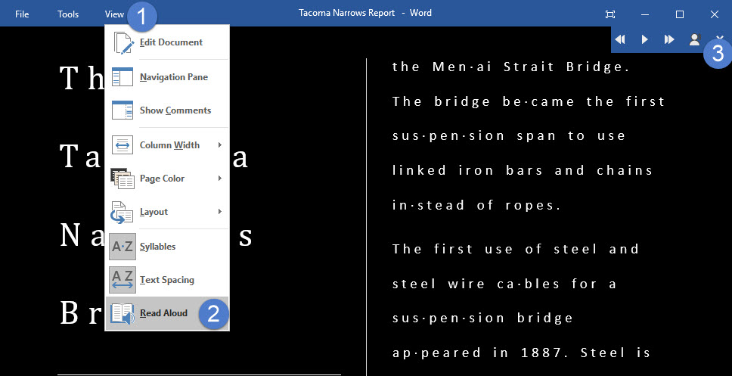
Consume Content Independently
Learning Tools
Screen Readers
Ease of Access Settings
Notes:
Learning Tools are free tools that implement proven techniques to improve reading and writing for people regardless of their age or ability. They include tools that read text out loud, break it into syllables, and increase spacing between lines and letters. They are built into Word, OneNote, Outlook and more. Learn more at https://www.onenote.com/learningtools
Screen reader and keyboard navigation Keyboard shortcuts and screen readers make Office apps accessible to users with low or no vision. Aka.ms/OfficeAccessibility outlines how various Office 365 apps can be used efficiently with screen readers and keyboards
Ease of Access Settings in Windows 10—Allow the user to personalize their PC and how they access content to better meet their vision, mobility, hearing or learning needs. Over the last year, a lot of thought and effort has gone into improving the productivity experiences when ease of access settings are enabled. For example, Office 365 usability in high contrast mode has been significantly enhanced, improving the user’s experience through bolder colors, cleaner graphics and increased usability with shapes and charts.

Slide 6
Learning Tools Availability
Feature | Apps & Platforms
Text to Speech and word/line highlighting | OneNote Desktop | OneNote Online | OneNote Windows App | Word Desktop | Word Online | Outlook Web Access | Office Lens on iOS | Edge browser
Spacing and Font Size | OneNote Desktop | OneNote Online | OneNote Windows App | Word Desktop | Word Online | Outlook Web Access | Office Lens on iOS | Edge browser - ePub
Syllables | OneNote Desktop | OneNote Online | OneNote Windows App | Word Desktop | Word Online | Outlook Web Access
Parts of Speech | OneNote Desktop | OneNote Online | OneNote Windows App | Word Online | Outlook Web Access
Line Focus | OneNote Online | OneNote Windows App | Word Online | Outlook Web Access
Dictation | OneNote Desktop | Word Desktop | Outlook Desktop | PPT Desktop

Slide 7





Learning and consumption tools in Office 365
Office Lens
Learning Tools
Dictate
Read Aloud
Editor
Take content from the analog to the digital world
Immersive Reader available for Office Lens on iOS
Comprehension, fluency and decoding aids
Word, OneNote, Outlook Web Access, and EDGE
Use voice to get your best thoughts into your documents
Word, Excel, PowerPoint, OneNote, Outlook
Read your content with simultaneous word highlighting
Word, OneNote, Outlook Web Access, and EDGE
Write easy-to-read documents, with more confidence
Word, Excel, PowerPoint, OneNote, Outlook
Notes:
Office Lens on iOS, allows users to take a photograph of printed text, in a textbook for example, and convert the printer text to digital content that they can view in an immersive reader with increased spacing and have that content read aloud.
Learning Tools, which is in Word and OneNote on various endpoints helps people improve their reading skills, including gifted learners, students with learning differences.
It's been shown to improve learning outcomes associated with:
Comprehension
Decoding
Fluency
Dictate, is a free add-in available for all Office apps, that users can install on their device, and use for speech-to-text.
Read Aloud, is a feature that exists within Learning Tools and as a standalone feature in Word’s Review tab, which allows anyone to easily have their content read aloud to them.
Editor is our enhanced set of proofing tools that helps people of all abilities to write easy-to-read documents, with more confidence. It does this by
Reducing the energy spent on low-level processing like spelling
To free up mental “desk space” for the higher-level cognitive tasks in writing (such a conceptual work, composition, structure)

Slide 8
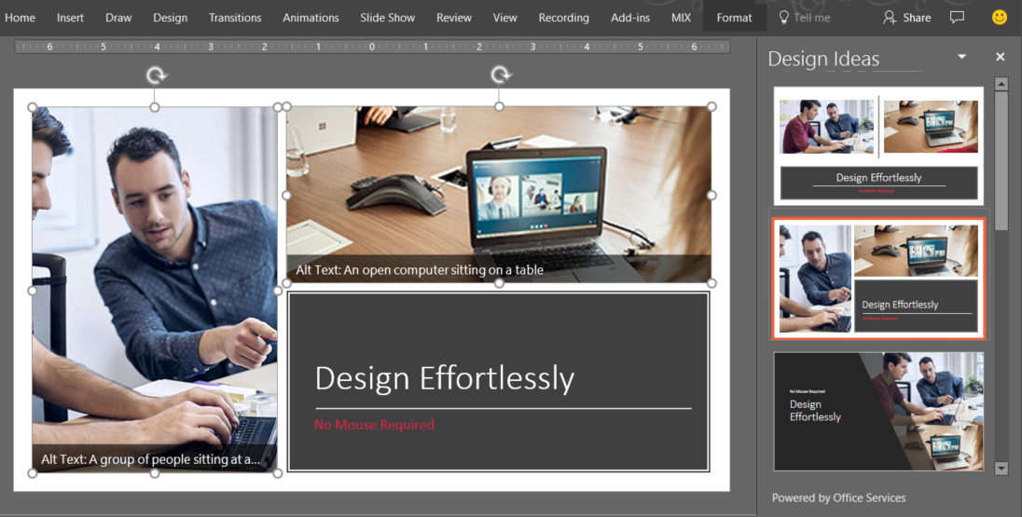
Create Confidently
Tell Me
Designer
Editor
Notes:
Editor checks your document or email message for spelling and grammar errors, and makes suggestions for writing style. Suggestions are based on the context of your writing, using machine learning and natural language processing. It is inclusively designed and easy for people with learning and visual impairments to use. Learn more at aka.ms/Editor
PowerPoint Designer—Often, people become so hung up on the design process when creating a PowerPoint presentation that the content itself becomes the secondary focus. PowerPoint Designer helps the user create beautiful looking slides without having to manually format pictures, create bulleted lists or place graphics. Learn more about PowerPoint Designer at https://blogs.office.com/2016/03/24/powerpoint-designer-whats-new-and-whats-next/
People who use screen readers struggle trying to get around the computer efficiently without using too many steps and clicks. The “Tell me what you want to do” feature in Office makes this efficient. To activate the feature, you can either click Tell Me on the ribbon in Office 2016 and Office Online or use the keyboard shortcut Alt+Q and type in what you need. For example, if you want to start researching a topic, just type in “Researcher” and it will take you to the feature you want within the Office application. Learn more about Tell Me at https://blogs.office.com/2014/05/15/get-more-done-with-tell-me/

Slide 9
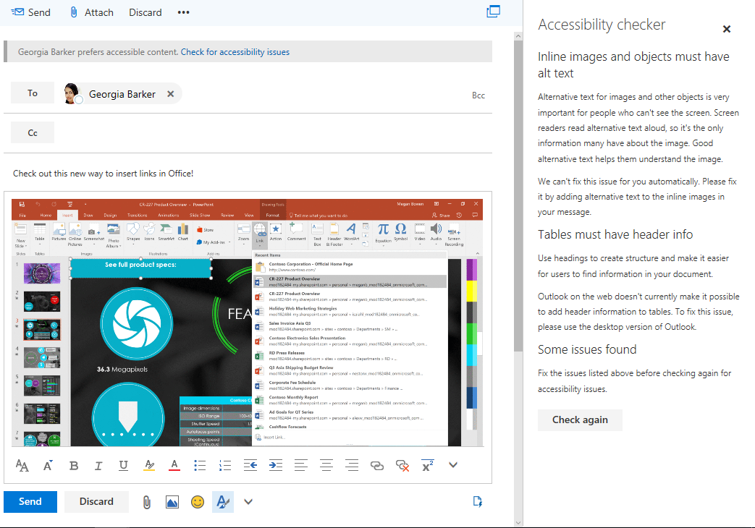
Collaborate Inclusively
Automatic Alt Text
Accessibility Checker
Automatic Closed Captions
Notes:
As you communicate, it is important to meet the diverse needs of your audience. Making your content accessible ensures it can be used without barriers by people with varying levels of vision, hearing, cognition and mobility.
Noteworthy new capabilities built into Office 365 to help you with this include:
Accessibility checker—Before sharing content, you can run the accessibility checker to find and fix any issues that might make your content difficult for people with disabilities to use. The accessibility checker is now easily discoverable in Word, Excel, PowerPoint and OneNote for PC applications via the Check Accessibility button under the Review tab. It is also available in Visio for PCs and several Office for Mac and Office Online applications. It not only finds accessibility errors and tells you how and why to fix them, but also links to detailed support articles on creating accessible documents, accessible spreadsheets, accessible presentations and accessible emails.
Accessible templates—When you create content starting with an online template in Word, Excel or PowerPoint for PC or Mac, you can now find templates tagged as “accessible.” These are structured to ensure ease of navigation with a screen reader and keyboard and use fonts and colors that are easy to read with low vision or color blindness.
Image description controls—When you use visual objects to communicate information, you need to add alternative text descriptions (alt-text) to ensure this content can be understood by people with visual impairments. To make this process easier, we now offer you controls to add alt-text not only in Office for PC, Mac and Office Online, but also in several Office mobile applications. Furthermore, we are designing ways to make alt-text easier to discover and use. We merged the title and description fields in the alt-text control into a single field so you have no confusion about where to enter alt-text. Also, we made this control discoverable via the right click menu and ribbon. Lastly, using the Microsoft Computer Vision Cognitive Service, we offer you automatic suggestions for alt-text when you insert a photographic image that can be recognized with high confidence. Through machine learning, this service will keep improving as more people use it, saving you significant time to make media-rich presentations accessible.

Slide 10
Creating a more productive, inclusive & compliant workplace with Office 365 accessibility
BOOST EVERYONE’S PRODUCTIVITY
SIMPLIFY IT & SUPPORT
MEET ACCESSIBILITY REQUIREMENTS

Slide 11
Office 365 enables productive workplaces
BOOST EVERYONE’S PRODUCTIVITY
SIMPLIFY IT & SUPPORT
MEET ACCESSIBILITY REQUIREMENTS
Offers enhanced usability with assistive technologies, access settings, keyboards and immersive readers
Makes it easy for everyone to create accessible content and make meetings inclusive
Step by step guidance available on Office Accessibility Center

Slide 12
Office 365 enables inclusive workplaces
BOOST EVERYONE’S PRODUCTIVITY
SIMPLIFY IT & SUPPORT
MEET ACCESSIBILITY REQUIREMENTS
Enables making accessible intranet sites with SharePoint Online first-party web parts such as document libraries
Reduces reliance on add-ons for accessible content & reading
Support available for organizations by Microsoft accessibility specialists

Slide 13
Office 365 enables compliant workplaces
BOOST EVERYONE’S PRODUCTIVITY
SIMPLIFY IT & SUPPORT
MEET ACCESSIBILITY REQUIREMENTS
Designed to meet global accessibility standards
Conformance reported transparently in aka.ms/508VPATs, aka.ms/EN301549, and aka.ms/WCAG2.0; informed by DHS Trusted Tester code-based inspection process

Slide 14

For creating accessible content - released
Office 365 Accessibility Highlights — Released
RELEASED IN CY2016
RELEASED IN CY2017 (JAN – SEPT)
Accessibility checkers and alt-text support in all Office 365 PCs, Mac and web apps and Accessible Templates
MailTip in Outlook on the web to request accessible content
Save as tagged PDF from Word for Mac*
Automatic suggestions for alt-text* in Word and PowerPoint
Insert links to recent files with automatic display text in Office 365 PC, Windows 10 and Android apps
Embed a video recording of a presenter narrating in Ppt and Sway*
Accessibility Checker available in Visio Online
* Some capabilities based on machine intelligence services not yet available in restricted clouds such as GCC

Slide 15
For creating accessible content - planned
Office 365 Accessibility Highlights — Planned
PLANNED FOR FUTURE RELEASES
Document accessibility compliance checker for IT
Accessibility Checker Improvements in Office 365 apps for PCs (controls surfaced within checker to fix detected issues, issues detected for Section 508 or WCAG2.0 AA, have color violations detected in Office Art)
Accessibility Checker coming in SharePoint
Alt-text improvements (Automatic alt-text for images in Sway, Single Field Alt Text Panes with Spell Check and Mark as Decorative for images in Word for PCs)
Mail tips in Outlook for PC to request accessible content
* Some capabilities based on machine intelligence services not yet available in restricted clouds such as GCC

Slide 16

For people with learning impairments (dyslexia, dysgraphia) - released
Office 365 Accessibility Highlights — Released
RELEASED IN CY2016
RELEASED IN CY2017 (JAN – SEPT)
Learning Tools in OneNote for PCs, Word for PCs, Office Lens for iOS
Editor context menu in Word and Outlook for PCs
Learning Tools in Word Online, OneNote Online, OneNote for Windows 10 and Outlook on the Web, with a new Line Focus Mode
Editor task pane in Word and Outlook for PCs for advanced spelling, grammar, and writing styles recommendations
Write Ideas from Microsoft Garage, an iOS pre-writing app that provides the structure and space to speak, type, and draw ideas
* Some capabilities based on machine intelligence services not yet available in restricted clouds such as GCC

Slide 17
For people with learning impairments (dyslexia, dysgraphia) - planned
Office 365 Accessibility Highlights — Planned
PLANNED FOR FUTURE RELEASES
Editor coming to Word Online for advanced spelling checking, inclusive and plain language critiques
Read Aloud coming in Office on iOS and Outlook for PCs
Picture Dictionary for OneNote
* Some capabilities based on machine intelligence services not yet available in restricted clouds such as GCC

Slide 18

For people with visual impairments - shipped
Office 365 Accessibility Highlights — Released
RELEASED IN CY2016
RELEASED IN CY2017 (JAN – SEPT)
Key productivity experiences made efficient for screen reader and keyboard users in Word, Excel, PowerPoint, Outlook, Sway*, SharePoint and more
New accessible navigation experience in OneNote for Windows 10, Mac, iOS, Android and OneNote Online
Modern sound feedback with seamless install
Ease of access center to find accessibility settings in Office for PCs
Improved ribbon navigation experience in Office for PCs
Screen reader support for Visio Online & Visio Viewer iOS
High Contrast Support for Visio Online and enhanced contrast ratio for themes in Visio.
* Some capabilities based on machine intelligence services not yet available in restricted clouds such as GCC

Slide 19
For people with visual impairments - planned
Office 365 Accessibility Highlights — Planned
PLANNED FOR FUTURE RELEASES
More intuitive slide reading experience for screen readers and improved table navigation support in PowerPoint for PCs
Narrator scan mode usability improvements with Office for PCs, improved announcements for misspellings, tables
Rotor support in Office for iOS to navigate headings, shapes, links, comments, charts, tracked changes, and regions
Improved screen readouts for Connectors & Shapes in Visio
* Some capabilities based on machine intelligence services not yet available in restricted clouds such as GCC

Slide 20

For people with mobility impairments – released
Office 365 Accessibility Highlights — Released
RELEASED IN CY2016
RELEASED IN CY2017 (JAN – SEPT)
New, intuitive ways to create and navigate mouse-free: Tell Me in several Office 365 apps, Designer in PowerPoint for PCs, Researcher* in Word for PCs
Access Keys supported in Office Online
Hands free typing for Outlook, Word and PowerPoint with Dictate add-in from Microsoft Garage*
Tell Me in Office for iOS and OneNote for Windows 10
Designer in PowerPoint Online
In App Chat & File Navigation for WXP PC
* Some capabilities based on machine intelligence services not yet available in restricted clouds such as GCC

Slide 21
For people with mobility impairments - planned
Office 365 Accessibility Highlights — Planned
PLANNED FOR FUTURE RELEASES
Tell Me in Office for Mac
Tell Me for suggesting commands, people, files, answers for word definitions, math calculations and facts
Built-in dictation capabilities in Office for PCs and Office Online
* Some capabilities based on machine intelligence services not yet available in restricted clouds such as GCC

Slide 22

For people with hearing impairments - released
Office 365 Accessibility Highlights — Released
RELEASED IN CY2016
RELEASED IN CY2017 (JAN – SEPT)
Automatic live captions in Skype for Windows 10 for consumers and in preview in Skype Meeting Broadcast
Support playing back closed captions in PowerPoint
Automatic live captions* in PowerPoint with Presentation Translator add-in from Microsoft Garage
Auto-generated captions and transcriptions in English and Spanish for videos in Microsoft Stream
Support adding closed captions in PowerPoint and Sway*
* Some capabilities based on machine intelligence services not yet available in restricted clouds such as GCC

Slide 23
For people with hearing impairments - planned
Office 365 Accessibility Highlights — Planned
PLANNED FOR FUTURE RELEASES
Read aloud in Outlook for PC
Read aloud in Word iPAD supported for all languages
* Some capabilities based on machine intelligence services not yet available in restricted clouds such as GCC

Slide 24
Questions or feedback?
Stay connected: twitter.com/msftenable
Get support from an expert: aka.ms/accessibilitysupport
Offer suggestions to help us improve: aka.ms/accessibilityfeedback

Slide 25
THANK YOU!!!!!

Slide 26
Contact info
Dean Halstead deanh@microsoft.com
Anita Sederstrom anitase@microsoft.com
Peter Frem pefrem@microsoft.com
Hani Loza hanil@microsoft.com
Aneetha Jayaraman anjaya@microsoft.com
Will Lewis wilewis@microsoft.com
Jiaxin Zheng jizhe@microsoft.com
Enterprise Disability Answer Desk eDAD@Microsoft.com

Slide 27
Links to bookmark and share
Office 365 Accessibility Support Documentation aka.ms/OfficeAccessibility
Answer Desk for Accessibility Support aka.ms/eDAD
Microsoft Accessibility Overview Microsoft.com/Accessibility
Windows 10 Upgrade for AT Users Microsoft.com/Accessibility/Windows10Upgrade
Conformance Documents
aka.ms/508VPATs and aka.ms/WCAG2.0

